Slide 1
F-Algebras and Cedille
Eric Bond
Purpl 2019

Slide 2
Motivation
What?
Representing inductive datatypes as functions in a generic and modular way.
How?
Separate the 'shape' of a type from its inductive definition
Shape of a datatype represented as a functor
Use a single generic fixedpoint to generate inductive types from functors.
Define one step of a recursive function as an algebra
Use a single generic fold to generate recursive functions from algebras
Why?
Modular extensible inductive datatypes as functions!
See Datatypes a la Carte
Modular extensible proofs!
See Meta-Theory a la Carte
Notes:
For inductive datatypes, we represent the shape of the type with something called a Functor.
The idea being to extract the shape of the type from the inductive definition.
To reconstruct the inductive type, we apply a general fixpoint (Fix) operator to the shape of the type.
The same principal can be applied to functions over that type.
We define one step of a recursive function as something called an Algebra. Then use a generic recursive function (fold) to create the desired recursive function
WHY
Expression problem & composable data/proofs
At a high level, expressing datatypes and functions in this way allows for modular definitions where individual components can be taped together to make new definitions.
See Datatypes a la carte
Furthermore, this can be extended to proofs over inductive data types.
Beyond the scope of this talk
See Meta-Theory a la carte

Slide 3
Outline
F-Algebras
Definitions
Inductive datatype as least fixpoint of a functor
Functions on inductive datatypes as algebras
Mendler style F-Algebras in Cedille
Lambda encoded inductive types
Functions with explicit control of recursive call
Notes:
So the general outline for this presentation will be to show how to encode common inductive datatypes as functors using haskell for the examples
Once we have a few examples, I'll go over the mathematical definitions more formally
Then I'll transition into defining functions over these types as Algebras. And how to construct the generic fold operation that takes in an algebra and returns a recursive function.
Finally Ill show a limitation of recursive functions defined by F-Algebras and how to get more generic recursion schemas through the use of Mendler style F-Algebras. This demonstration will be in Cedille.

Slide 4

An Old Friend
Nat

Slide 5

An Old Friend
Nat
Nat Functor

Slide 6

An Old Friend
Nat
Nat Functor

Slide 7
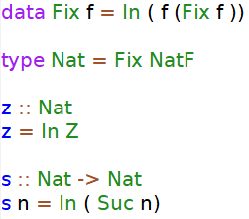
Least Fixed Point of a Functor

Slide 8
Least Fixed Point of a Functor

Slide 9

Another Old Friend
List

Slide 10

Another Old Friend
List
ListF

Slide 11
Another Old Friend
List
ListF

Slide 12
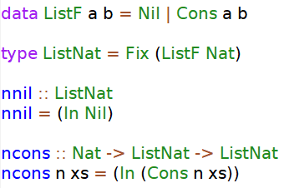
List as Least Fixed Point of a Functor

Slide 13
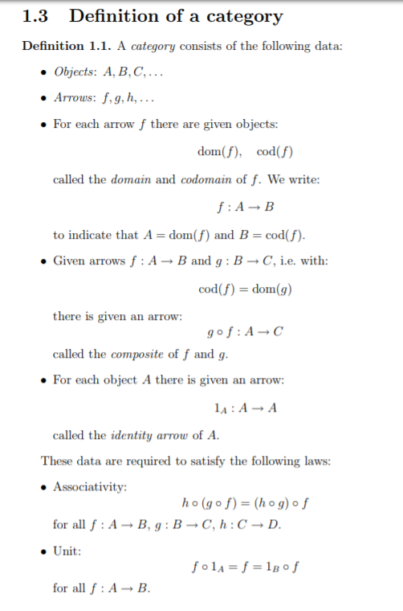
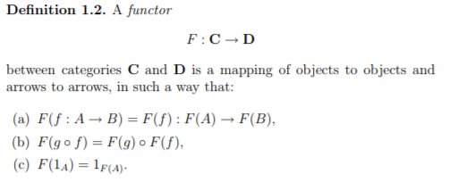
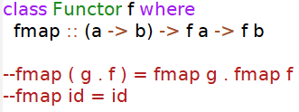
Definitions
Notes:
-- examples : Category of Finite Sets, Objects: Sets, Arrows : Set Functions
-- loose example Category Hask, Objects Types, Arrows, functions
-- here we specifically care about Endofunctors, when the Functor maps back into the same category

Slide 14

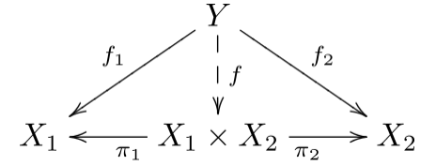
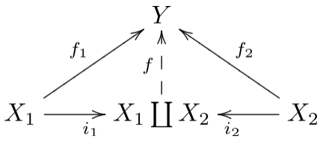
Represent Datatypes as Functors?
Components
Product - x
Coproduct - +
Unit - 1
Constant – A
Notes:
-components that respect functoriality
Functoriality – where an operation obeys (composition and identity on the objects and the arrows of a category)

Slide 15

Represent Datatypes as Functors?
Components
Product - x
Coproduct - +
Unit - 1
Constant – A
Nat
List

Slide 16
Friends
Nat
List
?

Slide 17
Friends
Nat
List
Binary Tree

Slide 18
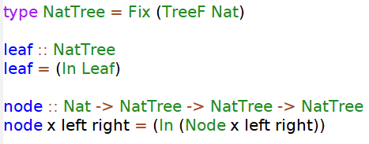
Binary Tree as Least Fixed Point of a Functor

Slide 19
F-Algebras

Slide 20
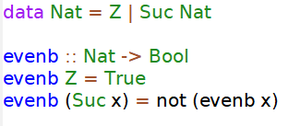
Functions as Algebras

Slide 21
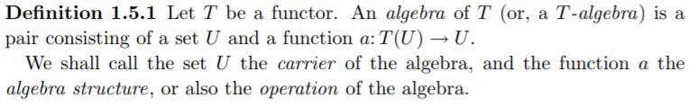

F-Algebra
Notes:
f is an instance of the functor type class

Slide 22
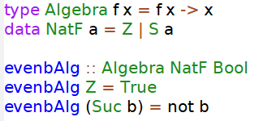

Functions as Algebras
Notes:
- look at typing of the algebra we want
- seems like the carrier should be Bool
- where is the value 'b' coming from?
- eventually, want a function from Nat -> Bool (Nat = Fix (NatF)) soo Fix (NatF) -> Bool
- fold will take in an algebra and give us a function from (Fix (NatF)) -> Bool
Fold :: Algebra f x -> Fix f -> x
Actually (Fold :: Functor f => Algebra f x -> Fix f -> x)

Slide 23
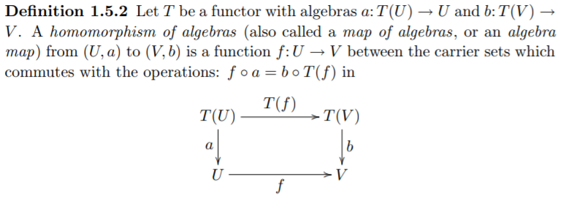
Homomorphism of Algebras

Slide 24
Category of Algebras of a Functor
For a given functor F,
Objects: F-Algebras
Pair ( X, a : F(X) -> X)
Morphisms: Algebra homomorphisms

Slide 25
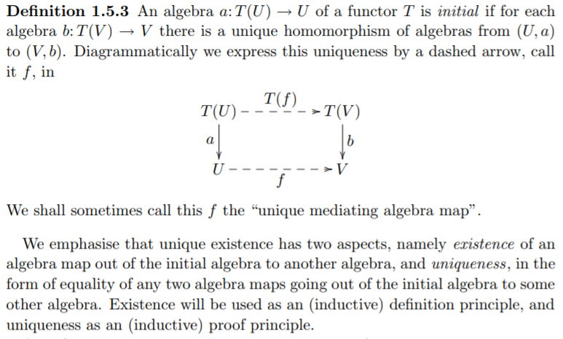
Initial Algebra
Notes:
Initial object in a category ------ initial algebra as the initial object in the category of algebras of a given functor
Initial algebras exists for polynomial functors

Slide 26

Initial Algebra of the NatF Functor

Slide 27


Initial Algebra of the NatF Functor

Slide 28

Back to the problem...

Slide 29
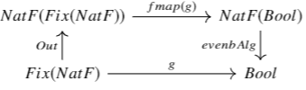
Back to the problem...

Slide 30

Back to the problem...
Notes:
-- fold is also known as a catamorphims

Slide 31
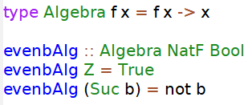

Functions as Algebras

Slide 32
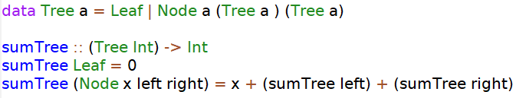
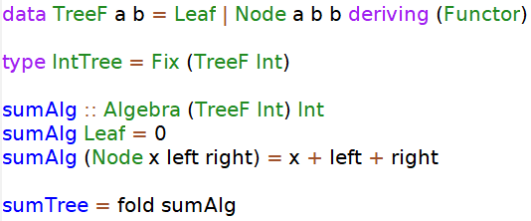
Another Example
Notes:
-- full example!
-- inductive type defined as a least fixed point of a functor
-- recursive function defined as a fold of an F-Algebra
--notice the recursion scheme however... in the algebra, the values left and right are fully evaluated sub expressions
-- this could be computationally inneficcient,
-- Idea, Use a different type of algebra to get explicit control of the recursion scheme
-- Mendler- Algebra is such an algebra!!,

Slide 33
Mendler Algebras in Cedille

Slide 34
What is Cedille?
Minimal core type theory with derivable induction principles
All data are lambda encoded
Possible to generically derive induction for Mendler-style lambda-encodings
Pure type theory extending the extrinsic Calculus of Constructions
Terms are just pure untyped lambda terms
Adds:
Implicit Product Type
Dependent Intersection Type
Heterogeneous Equality Type
Notes:
-- extrinsic meaning the type of a term is not part of the term, unlike coq where every term has its type
-- terms are checked against a type assignment system
--Mendler and Church style lambda encodings are isomorphic

Slide 35
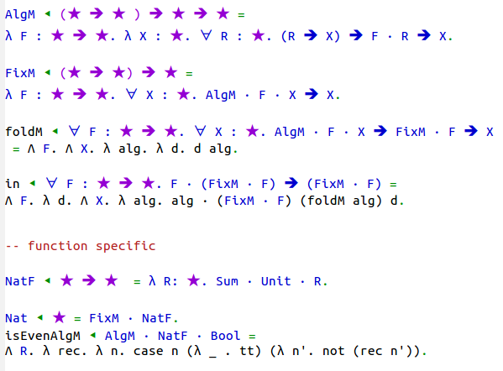
Mender-Algebra, NatF, and Evenb
Notes:
-- note this is a lambda encoded version of Mendler F-Algebras
-- can also express
-- Sum, Unit, Product are also lambda encoded data

Slide 36
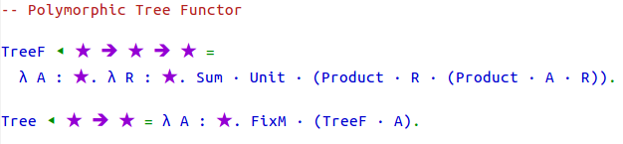
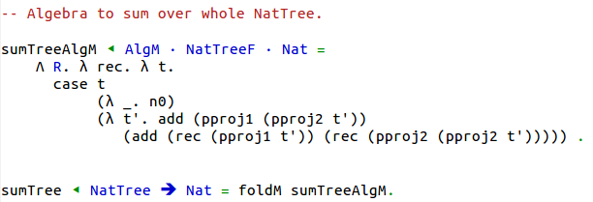
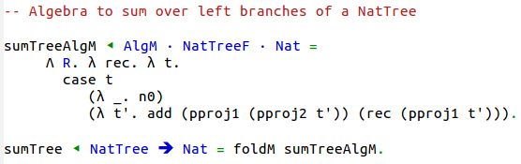
Explicit Recursive Calls using Mendler-Algebra

Slide 37
Wrapping up
F-Algebras
Inductive types as a least fixed point of a functor
Recursive functions as a fold of an algebra
Mendler-style F-Algebras
Explicit recursive calls
Cedille

Slide 38
References
https://homepages.cwi.nl/~janr/papers/files-of-papers/2011_Jacobs_Rutten_new.pdf
http://www.cs.utexas.edu/~wcook/Drafts/2012/MTC.pdf
http://www.cs.ru.nl/~W.Swierstra/Publications/DataTypesALaCarte.pdf
http://homepage.cs.uiowa.edu/~astump/papers/from-realizability-to-induction-aaron-stump.pdf
http://homepage.cs.uiowa.edu/~astump/papers/cpp-2018.pdf
https://kodu.ut.ee/~varmo/papers/thesis.pdf
https://www.schoolofhaskell.com/user/bartosz/understanding-algebras

